Slide 1
DROWSINESS DETECTION SYSTEM FOR DRIVERS
SERVE SOCIETY SAVE LIFE

Slide 2
PROBLEM STATEMENT
Road accidents caused by driver drowsiness are a major issue on today's highways. Drivers who are sleep-deprived or fatigued are more likely to make errors or react gradually over time to variations in traffic or road conditions, which can lead to accidents. Drowsy driving is responsible for approximately 100,000 crashes in the United States alone each year, resulting in thousands of injuries and fatalities. What's especially troubling is that these accidents can happen to anyone, regardless of age or driving experience, and they frequently happen early in the morning or late at night, when drivers are naturally more tired.

Slide 3
ABSTRACT
In our daily lives, many traffic accidents occur as a result of negligence, drunk driving, speeding, and tiredness. Drowsiness accidents are one of them that can be avoided.
According to a Google survey, between 3 and 30 percent of accidents on the road are caused by drivers who are too tired to sleep, most often those in heavy-duty vehicles travelling large distances that take more than a day. So, it is conceivable for the driver to be asleep or exhausted and have an accident.
The suggested answer is to actively watch the driver in real time to prevent accidents of such nature. The 68 landmarks on the driver's face are the center of our suggested solution, which employs an imutiles method based on machine learning to assess the driver's alertness and tiredness.
Arduino technology uses the driver's expression to send the driver a warning. Arduino and machine learning technology were used to actively watch the driver. The drivers' activity is constantly observed, and their performance can be enhanced.

Slide 4
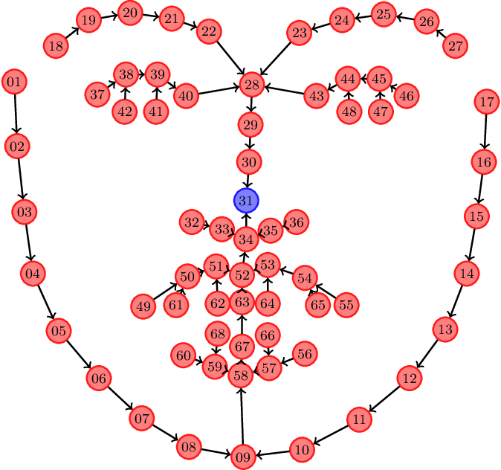
PROPOSED IDEA
With a mix of Imutils, NumPy, and hardware alerts developed with the Arduino IDE, deep learning may be used to create an effective solution for the drowsy detection of drivers.
Using a dataset of drivers and 68 landmarks dataset, the various alertness stages, such as alert, drowsy, and asleep, as well as their related facial features and head motions, a deep learning model can be developed.
In order to extract features from facial photos and head movement data, the deep learning model can use convolutional neural networks (CNNs) and recurrent neural networks (RNNs).
The driver can receive real-time alerts from the model as it learns to spot data patterns that point to tiredness. To increase driver safety on the road, this technology can be linked with additional technologies like in-car cameras or sensors.

Slide 5
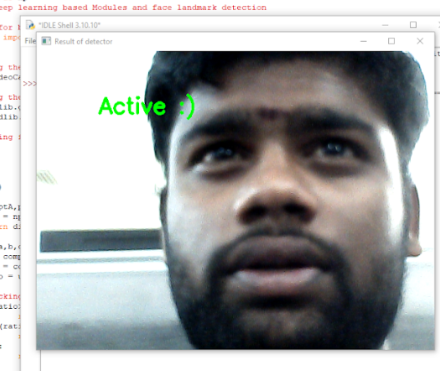
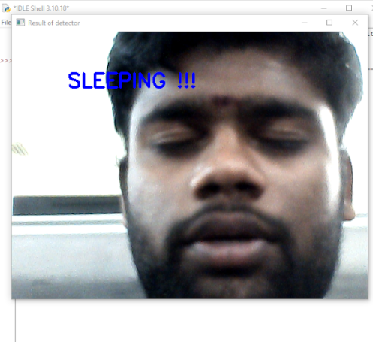
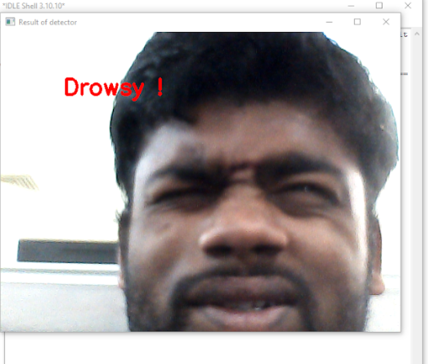
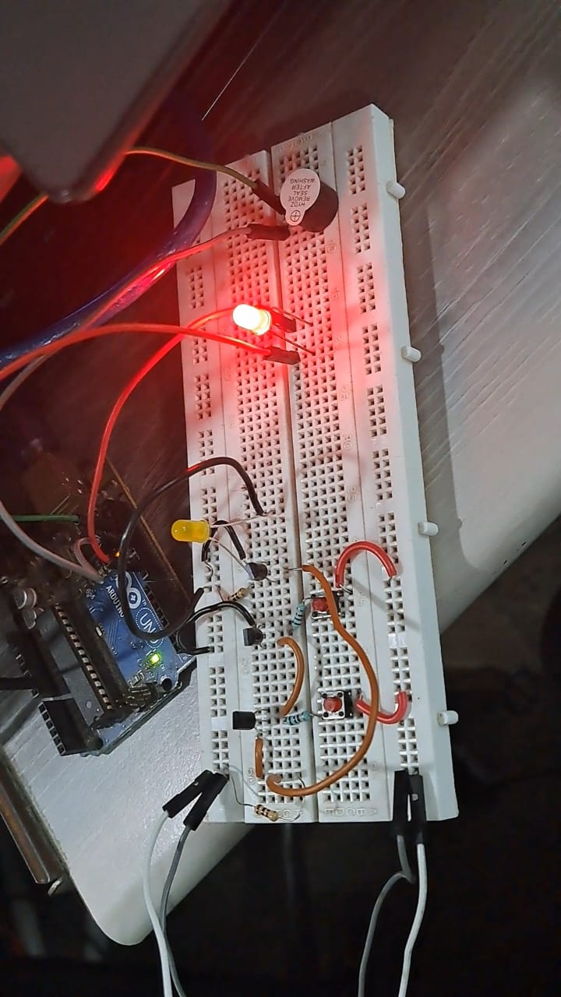
WHAT WE HAVE DONE SO FAR ??
When the driver becomes drowsy or sleepy, our system detects it (i.e., our system continuously captures or monitors the driver via the camera placed in front of him and alerts him via the buzzer placed there). So far, we have accomplished this. In our updated design, we will collect data (for example, how many times a person has become inactive) and store it. This option allows drivers and owners to be regularly monitored and their effectiveness to be enhanced.
+20.

Slide 6
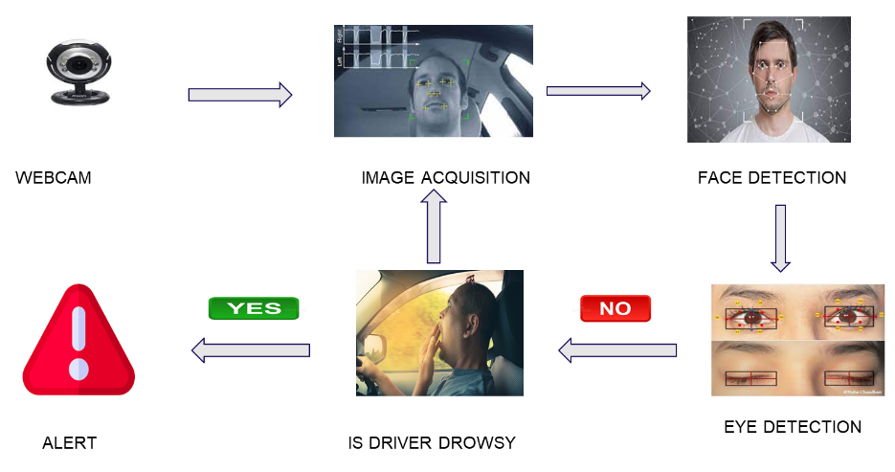
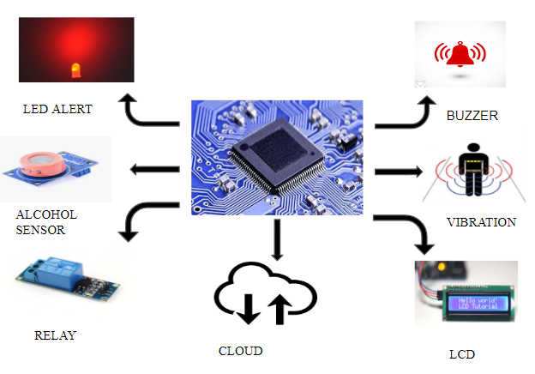
PROJECT FLOW

Slide 7
CONCLUSION
So, it's possible to conclude that our system will keep an eye on the drivers, warn them when they start to nod off, and regularly log their data. This helps them perform at a higher level and reduces traffic accidents by 90%. We can implement our model using CNN, RNN, and an Arduino-based alarm system, and deep learning is used to achieve this.

